Slide 1
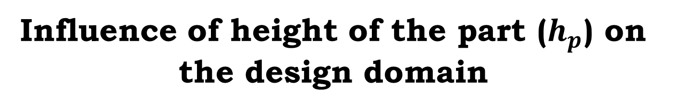
Influence of height of the part ($h_{p}$) on the design domain

Slide 2
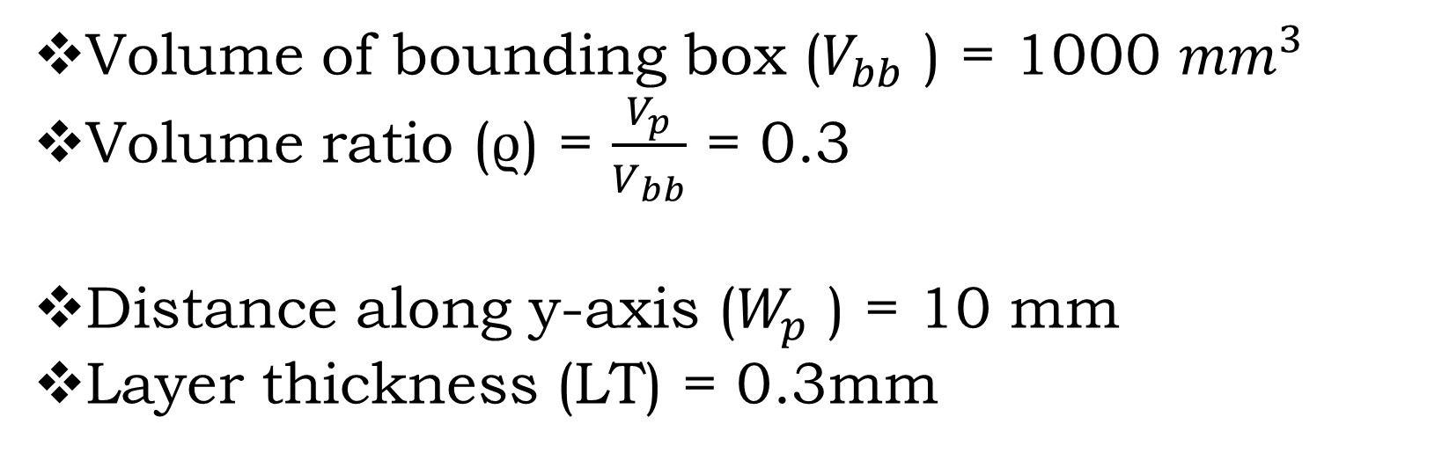
Volume of bounding box ($V_{bb}$ ) = 1000 ${mm}^{3 }$
Volume ratio (ϱ) = $\frac{V_{p}}{V_{bb}}$ = 0.3
Distance along y-axis ($W_{p}$ ) = 10 mm
Layer thickness (LT) = 0.3mm
Total cost (tc) = 87.58 + 145 [ ($\frac{\text{0.4356}}{h_{p}}$) + 0.137 $h_{p}$)

Slide 3
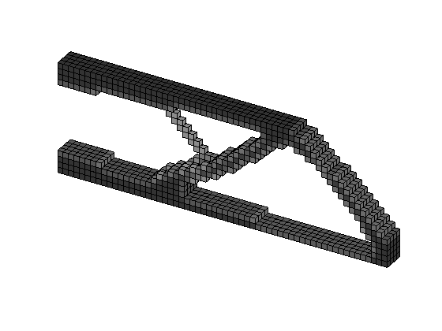
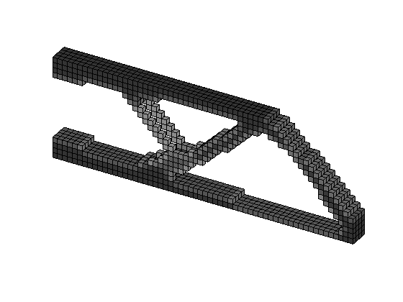






For $h_{p}$= 2.5
For $h_{p}$ = 5
For $h_{p}$ = 7.5
For $h_{p}$ = 10

Slide 4




Iteration | Objective | Volume | Iteration | Objective | Volume | Change | Elapsed time (s)
3.214717e+04 | 0.3000 | 0.011 | 207 | 33395.9163 | 31782.835 | 31684.466 | 434.976054
2.935970e+04 | 0.3000 | 0.010 | 155 | 29360.2887 | 27436.570 | 27436.570 | 286.798322
2.843652e+04 | 0.3000 | 0.023 | 162 | 28436.9533 | 26370.462 | 26370.462 | 274.446801
2.804168e+04 | 0.3000 | 0.010 | 167 | 28041.6755 | 25661.020 | 25661.020 | 322.133517
For $h_{p}$= 2.5
For $h_{p}$= 5
For $h_{p}$= 7.5
For $h_{p}$= 10
Influence of height of the part ($h_{p}$) on the design domain

Slide 5
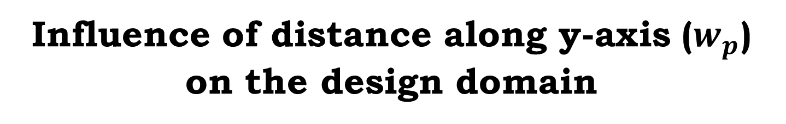
Influence of distance along y-axis ($w_{p}$) on the design domain

Slide 6
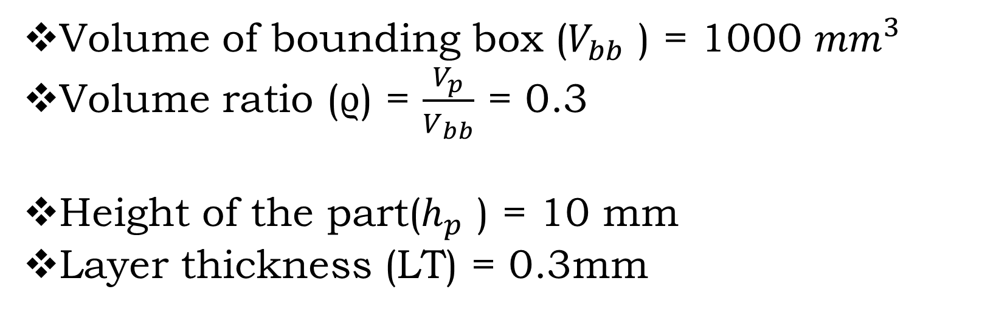
Volume of bounding box ($V_{bb}$ ) = 1000 ${mm}^{3 }$
Volume ratio (ϱ) = $\frac{V_{p}}{V_{bb}}$ = 0.3
Height of the part($h_{p}$ ) = 10 mm
Layer thickness (LT) = 0.3mm
Total cost (tc) = 87.58 + 145 ($\text{0.}\text{0}\text{4356}$ + 0.137 $w_{p}$)

Slide 7
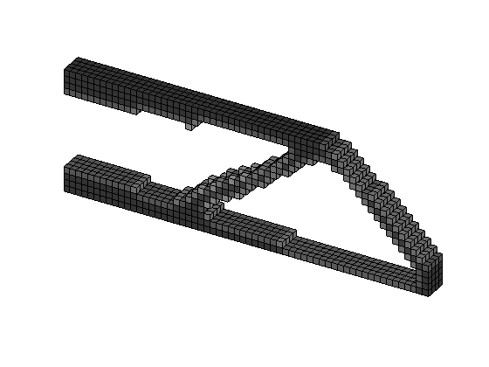
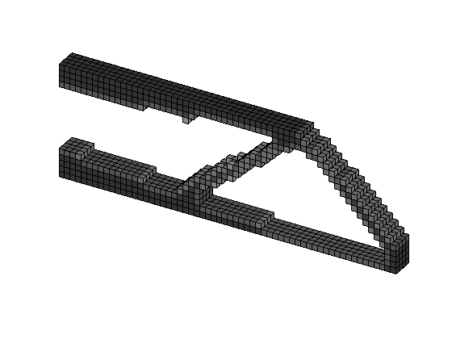
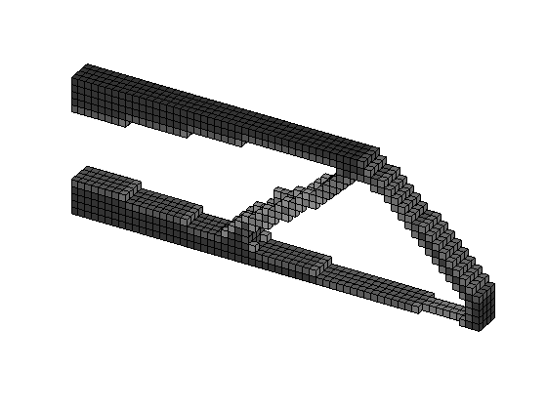
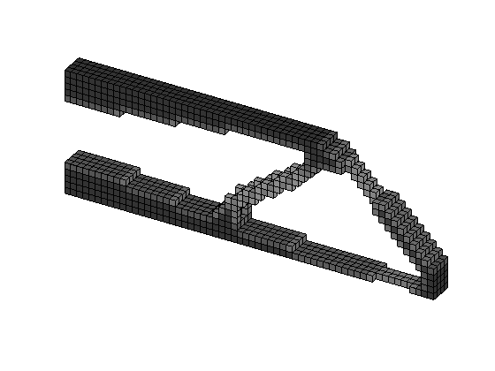




For $w_{p}$= 2.5
For $w_{p}$= 5
For $w_{p}$= 7.5
For $w_{p}$= 10

Slide 8




Iteration | Objective | Volume | Iteration | Objective | Volume | Change | Elapsed time (s)
4.105180e+04 | 0.3000 | 0.010 | 136 | 41052.2221 | 40306.233 | 40306.230 | 198.626936
5.496486e+04 | 0.3000 | 0.014 | 73 | 54965.4450 | 54514.182 | 54514.182 | 102.933617
7.022528e+04 | 0.3000 | 0.011 | 108 | 71220.5281 | 68764.216 | 68725.994 | 162.369220
8.576559e+04 | 0.3000 | 0.018 | 101 | 85766.7670 | 85463.746 | 85463.746 | 155.567380
For $w_{p}$= 2.5
For $w_{p}$= 5
For $w_{p}$= 7.5
For $w_{p}$= 10
Influence of distance along y-axis ($w_{p}$) on the design domain

Slide 9

Influence of Layer Thickness ($LT$) on the design domain

Slide 10
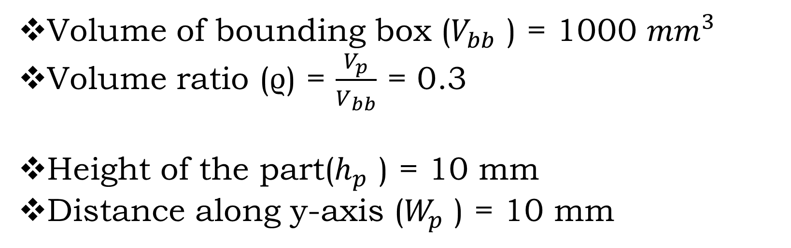
Volume of bounding box ($V_{bb}$ ) = 1000 ${mm}^{3 }$
Volume ratio (ϱ) = $\frac{V_{p}}{V_{bb}}$ = 0.3
Height of the part($h_{p}$ ) = 10 mm
Distance along y-axis ($W_{p}$ ) = 10 mm
Total cost (tc) = 87.58 + 145 [ ($\frac{\text{423.068}}{1000 LT}$)]

Slide 11




For LT = 0.3
For LT = 0.5
For LT = 0.7
For LT = 0.8

Slide 12
Iteration | Objective | Volume | Iteration | Objective | Volume | Change | Elapsed time (s)
8.562407e+04 | 0.3000 | 0.013 | 98 | 85625.1741 | 85325.926 | 85325.926 | 157.742093
6.027885e+04 | 0.3000 | 0.011 | 172 | 61140.3409 | 59609.735 | 59598.863 | 356.500211
4.983684e+04 | 0.3000 | 0.012 | 59 | 49835.1900 | 49061.832 | 49061.832 | 109.864996
4.674312e+04 | 0.3000 | 0.011 | 86 | 46741.1494 | 46379.122 | 46379.122 | 164.570945
For LT = 0.3
For LT = 0.5
For LT = 0.7
For LT = 0.9
Influence of layer thickness (LT) on the design domain

Slide 13

Influence of volume ratio ($\text{ϱ}$) on the design domain

Slide 14
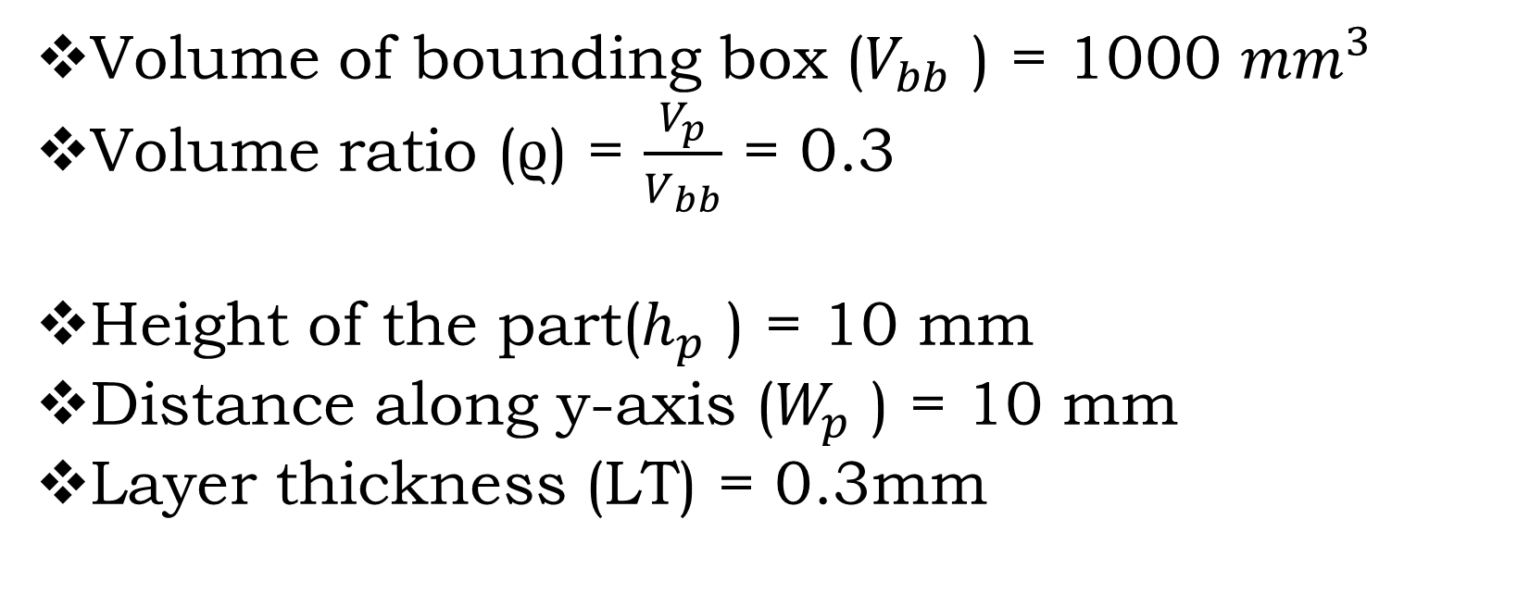
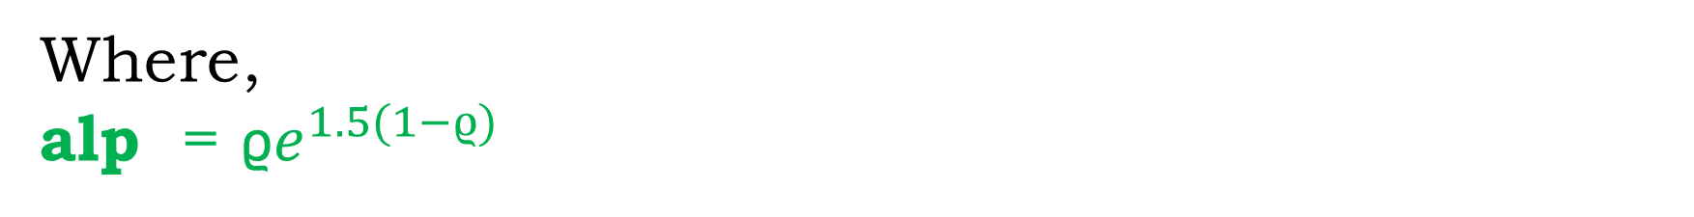
Volume of bounding box ($V_{bb}$ ) = 1000 ${mm}^{3 }$
Volume ratio (ϱ) = $\frac{V_{p}}{V_{bb}}$ = 0.3
Height of the part($h_{p}$ ) = 10 mm
Distance along y-axis ($W_{p}$ ) = 10 mm
Layer thickness (LT) = 0.3mm
Total cost (tc) = 87.58 + 145 [ ($\frac{\text{0.33}\text{alp}}{40 −39 alp}$) + 1.367]
Where,
alp = ϱ$e^{1.5(1−ϱ)}$

Slide 15
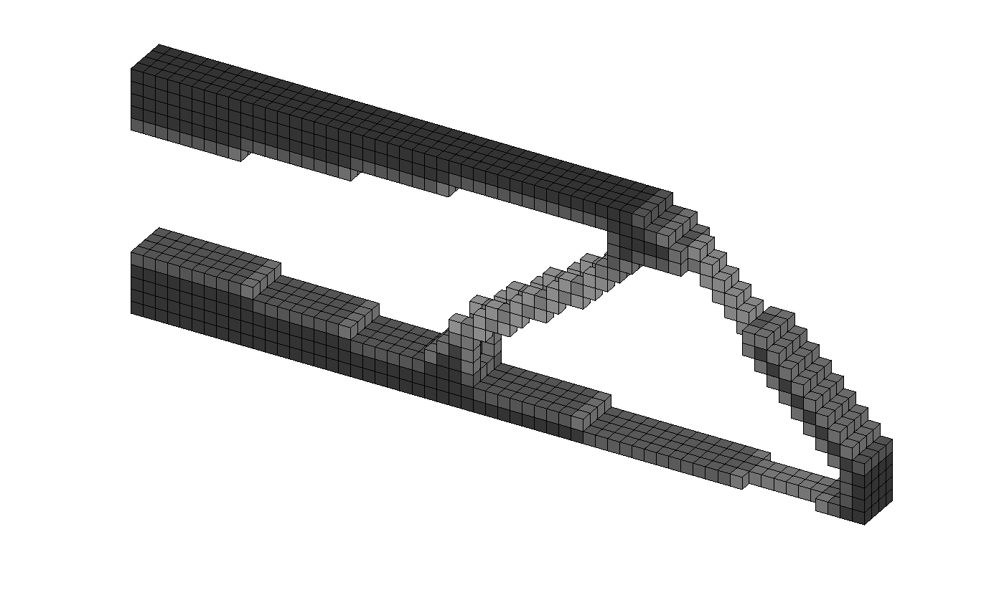

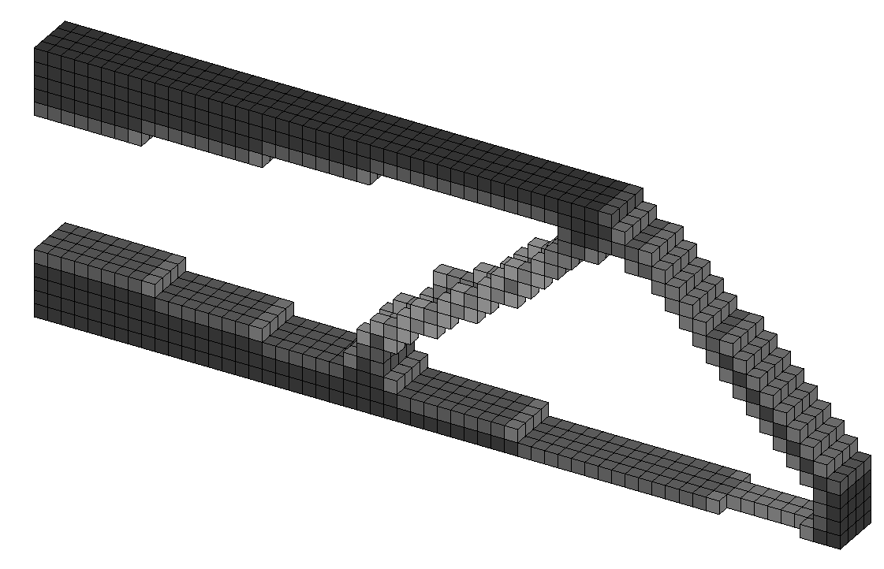
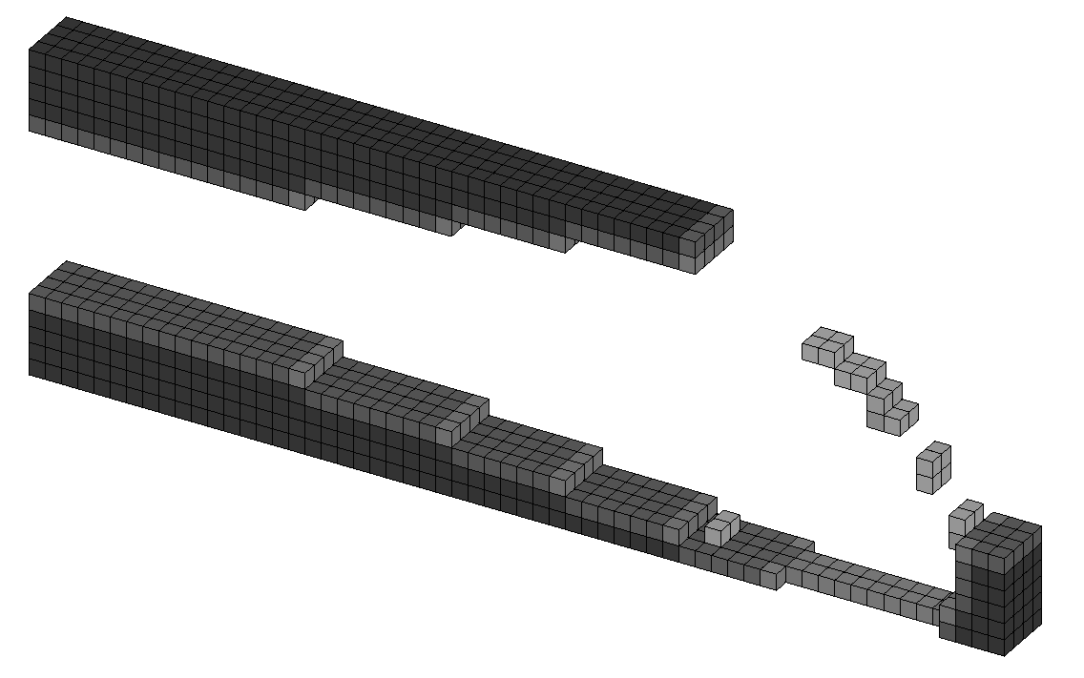
For ϱ = 0.25
For ϱ = 0.5
For ϱ = 0.75
For ϱ = 0.95

Slide 16
Iteration | Objective | Volume | Iteration | Objective | Volume | Change | Elapsed time (s)
8.488634e+04 | 0.3000 | 0.020 | 92 | 84888.0440 | 84588.856 | 84588.856 | 162.647429
7.111841e+04 | 0.3000 | 0.010 | 259 | 72382.8442 | 70176.913 | 70084.623 | 434.702430
7.772565e+04 | 0.3000 | 0.011 | 88 | 77727.1435 | 76974.206 | 76974.206 | 129.984856
3.154798e+05 | 0.3000 | 0.012 | 118 | 315432.0043 | 327826.336 | 328497.183 | 206.828385
For ϱ = 0.25
For ϱ = 0.5
For ϱ = 0.75
For ϱ = 0.95
Influence of volume ratio (ϱ) on the design domain

Slide 17
Influence of weight factor (w) on the design domain

Slide 18
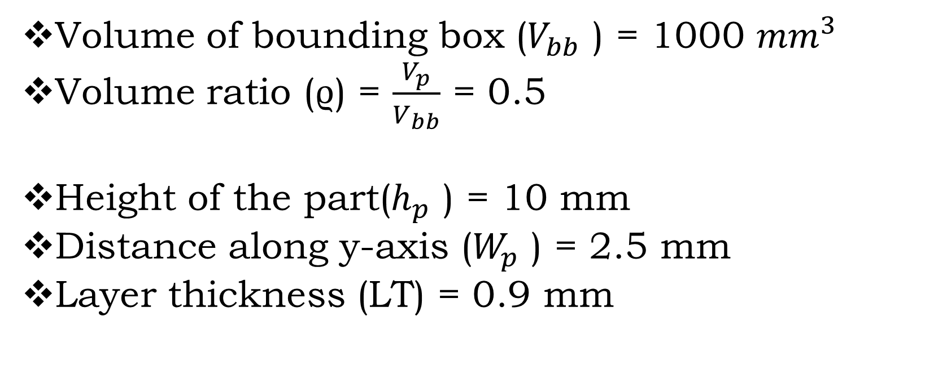
Volume of bounding box ($V_{bb}$ ) = 1000 ${mm}^{3 }$
Volume ratio (ϱ) = $\frac{V_{p}}{V_{bb}}$ = 0.5
Height of the part($h_{p}$ ) = 10 mm
Distance along y-axis ($W_{p}$ ) = 2.5 mm
Layer thickness (LT) = 0.9 mm
Total cost (tc) = 1.0327

Slide 19

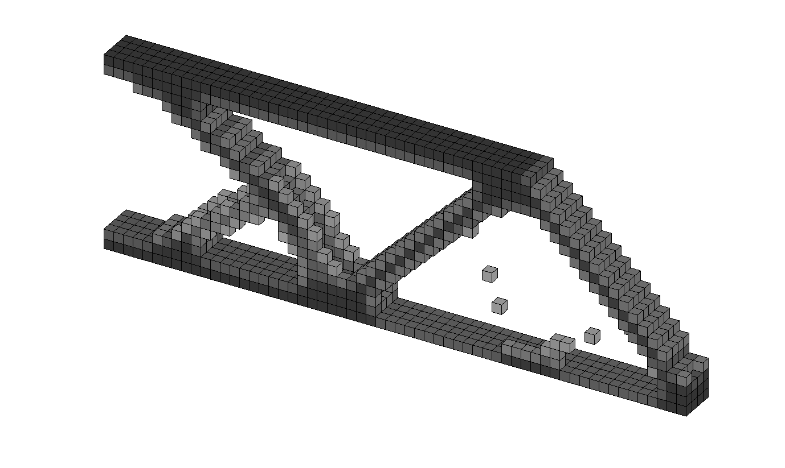

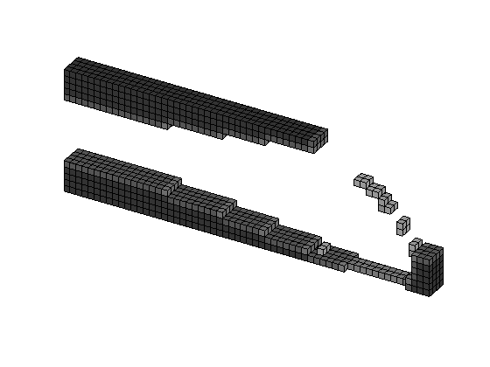
For ϱ = 0.25
For ϱ = 0.5
For ϱ = 0.75
For ϱ = 0.95

Slide 20
Weightage factor (w) | Iteration | Objective | Volume | Iteration | Objective | Volume | Change | Elapsed time (s)
0.25 | 9.561957e+02 | 0.3000 | 0.011 | 236 | 933.4503 | 818.816 | 831.150 | 404.699203
0..5 | 7.111832e+04 | 0.3000 | 0.011 | 260 | 72382.5433 | 70178.247 | 70084.912 | 413.577710
0.75 | 9.637995e+02 | 0.3000 | 0.010 | 206 | 940.1054 | 759.456 | 760.888 | 352.829279
1 | 3.154800e+05 | 0.3000 | 0.012 | 118 | 315432.0548 | 327825.795 | 328498.201 | 165.219556

